Slide 1
Multicomponent: Figures
Jonathan Aubuchon Ouimet, Laurianne Lair, Xinhong Liu, Alexander Dowling, William Phillip

Slide 2
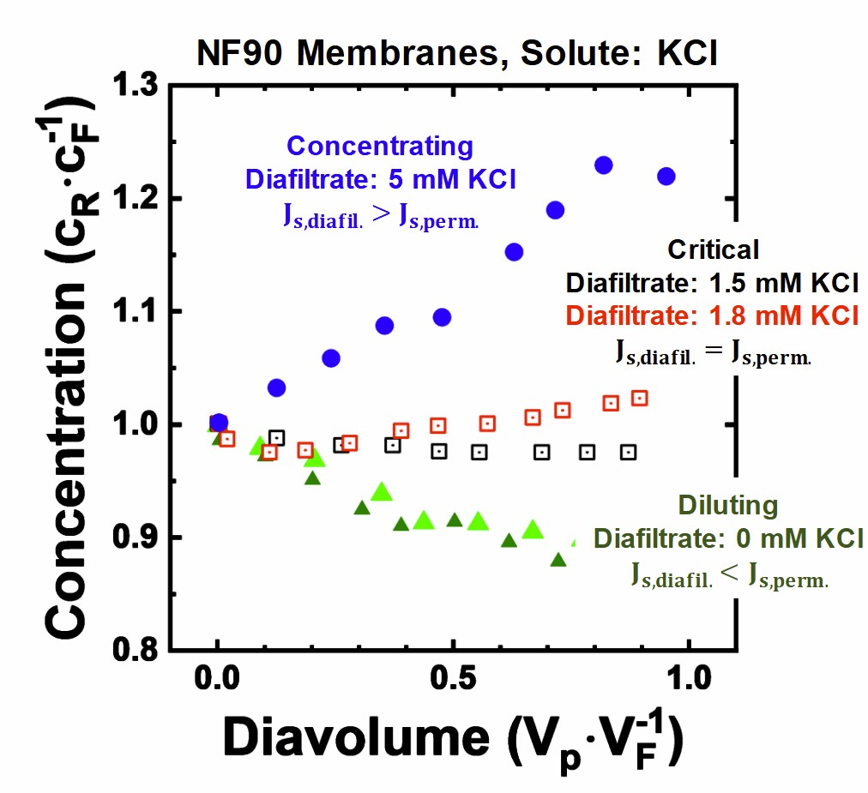
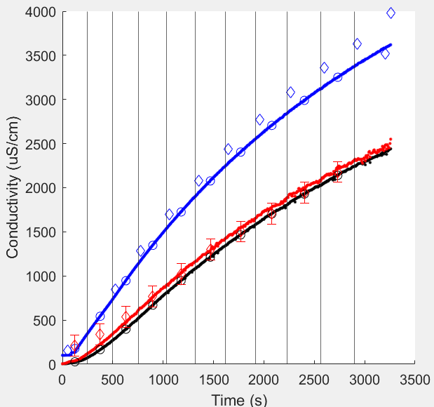
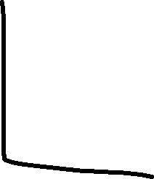


Figure 1: experimental data and operating regimes
NaCl – Single Component

Slide 3
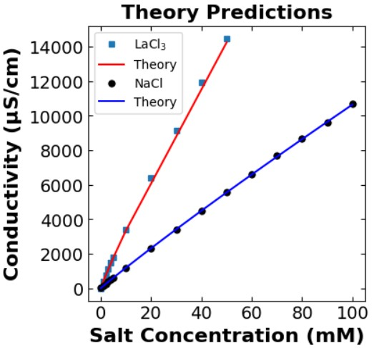
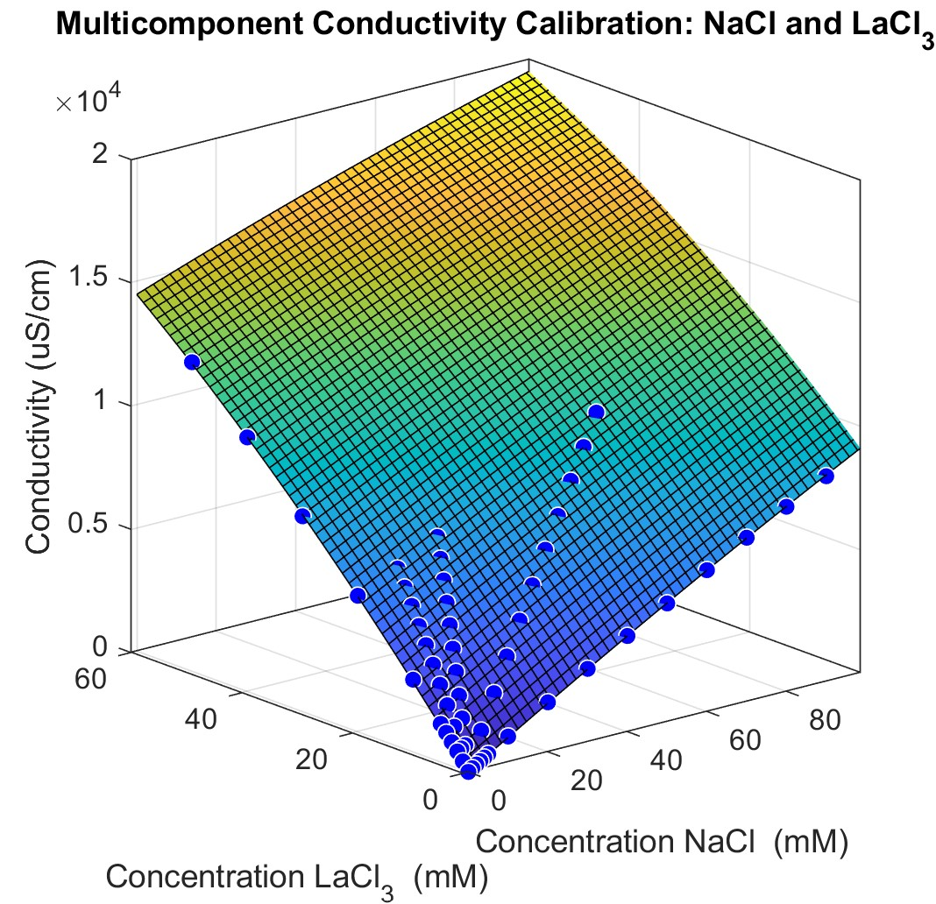
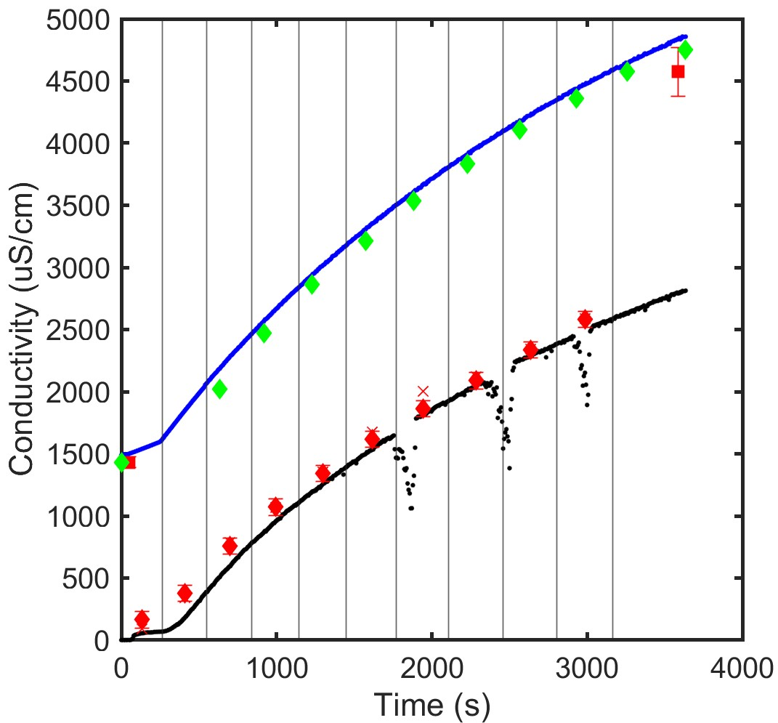
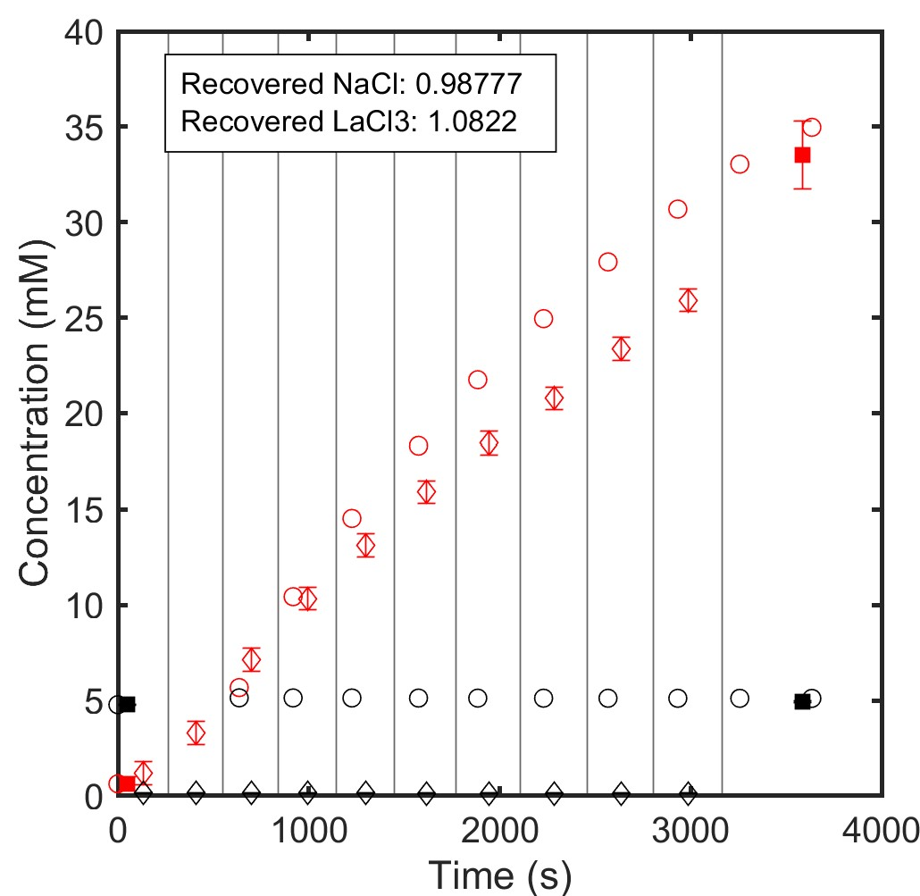
Single salt - SI
Figure 2: conductivity to concentration – identifying ions
Shammah theory – can decipher which salt is at what concentration.+ ICP

Slide 4
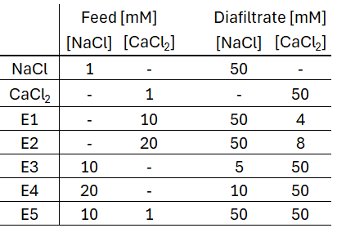




Figure 3: Concentration phase space for NaCl and LaCl3
Add a circle for where the feed is, and a star for the retentate (experiment ended).
Triangles are retentate concentrations that correspond to each permeate vial (calculated from a mass balance using ICP).
SI: Permeate concentrations.
Since La has high rejection, and Na increases a lot, all of the data sets will likely overlap.
SI
Retentate concentrations.

Slide 5
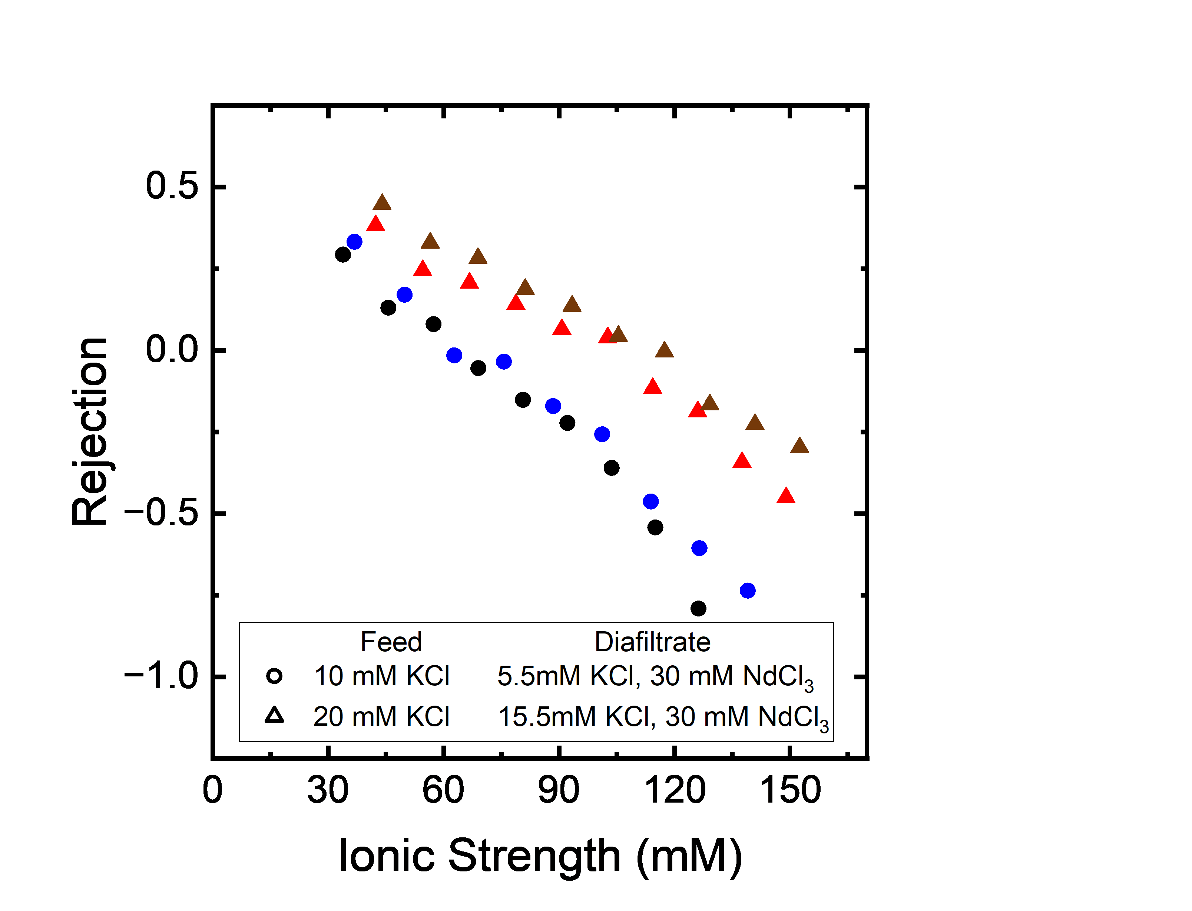
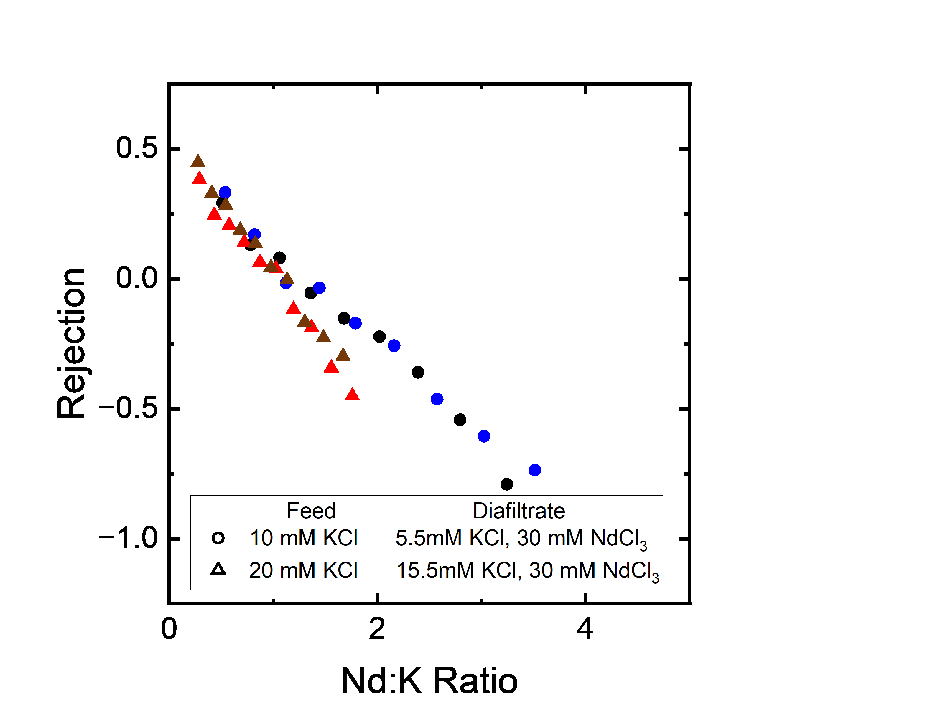











Figure 4: Multicomponent NaCl, LaCl₃ Experiments
Plots on the left only have K rejection.
Single salt NaCl
Single salt LaCl3
Constant NaCl increasing Lacl3 at conc #1
Constant NaCl increasing LaCl3 at conc #2
Increasing NaCl constant LaCl3 at conc #1
Increasing NaCl constant LaCl3 at conc #2

Slide 6
Figure 5: Three ion experiments (Na, Ca, La)
Read nature papers for membranes

